Slide 1



Introduction to ROS
Perception and Artificial Intelligence implemented in ROS

Slide 2
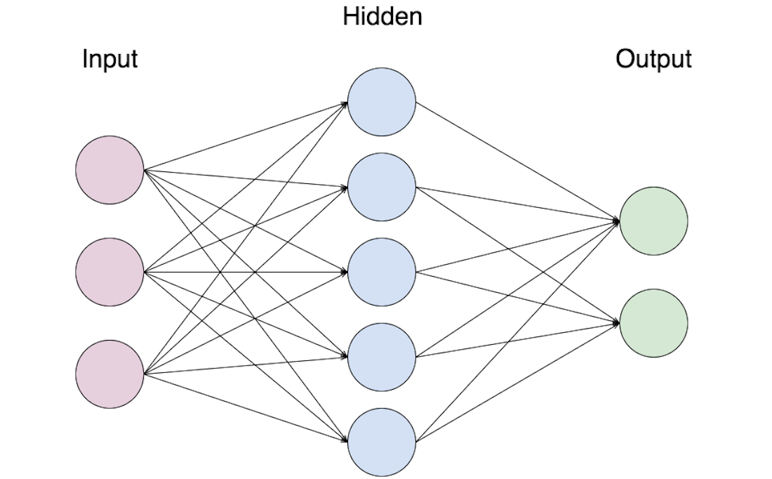
Introduction to neural networks What is a neural network?
Set of nodes (neurons) that take the information the user sends through the Input layer, apply some mathematical operations and send them back through the output layer.
Input layer
Neurons directly connected to the user input
Hidden layer
Neurons only connected to other neurons
Output layer
Neurons delivering the result

Slide 3
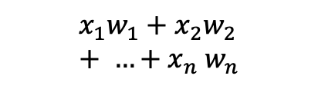
Introduction to neural networks What is a neuron?
Minimal element of a neural network, it takes as an input a weighted combination of numbers and outputs the result of applying a given function to it, known as activation function.
$$x_{1}w_{1}+x_{2}w_{2}+ …{+ x}_{n}w_{n}$$
Neuron with a sigmoid activation function

Slide 4
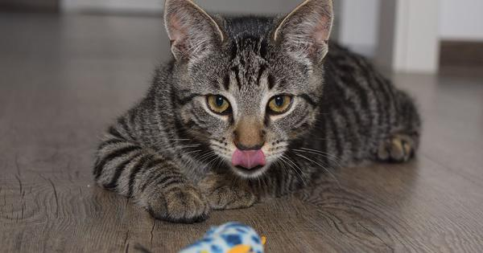
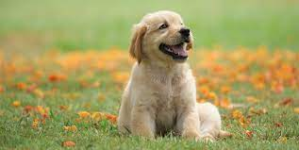
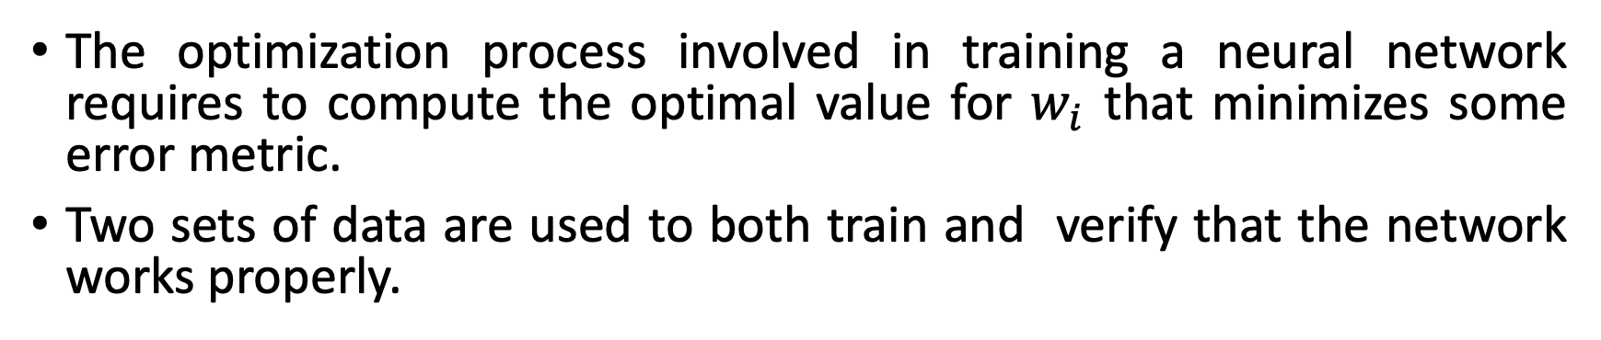
Introduction to neural networks How to set up a network?
The optimization process involved in training a neural network requires to compute the optimal value for $w_{i}$ that minimizes some error metric.
Two sets of data are used to both train and verify that the network works properly.
Database
Cat
Optimization
Dog

Slide 5
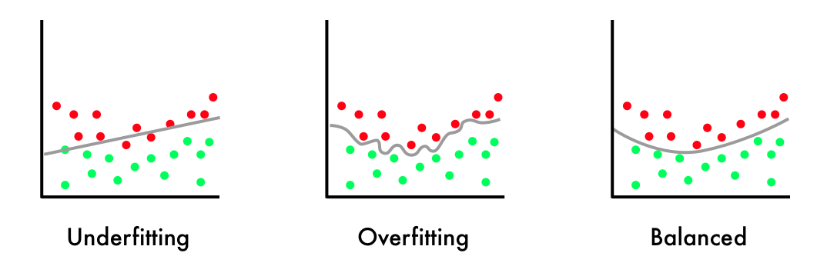
Introduction to neural networks Overfitting
When the network is too adapted to our data, we say it is overfitted.
This phenomena makes our network too stiff, it’s very good working with the data that we used to train it but it’s very bad with new samples, making in unusable in application.

Slide 6
Building an AI solution Generating a dataset
When picking a dataset all classes, for example cats and dogs when classifying animals, need to be equally represented to ensure that the network is not biased.
At the same time, we need to be sure that there are all types of dogs within the dataset to make the solution as general as possible.
Finally, the data should be normalized to reduce the influence of noise or artifacts in the data used in our application
Building a dataset pipeline
Capture Data
Problem
Resizing the images
Noise filtering
Grayscale image
Search
dataset
What do I need?
Preprocessing
Data acquisition

Slide 7
Building an AI solution Training a neural network
Training
Optimization
Yes
Training
Dataset
Network
Performance
metrics
Is it good
enough ?
Change dataset
Testing
Dataset
Network
No
Change architecture

Slide 8
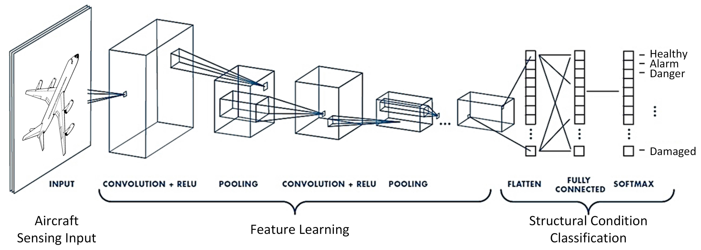
Shape recognition with AI Problem statement and proposed solution
The most common type of neural networks used with images are known as convolutional neural networks.
An image is going to be provided and the the extract some features and classify it.

Slide 9
Shape recognition with AI Preprocessing and regularization
In our example the original images are colored a and have different shapes, in order to process them we need to apply the following procedure.
Resizing the images to a common shape that matches the input of the network.
Apply histogram equalization to remove artifacts and reduce noise
Convert the data to grayscale
Normalize the data between 0 and 1
Resizing the images
Noise filtering
Grayscale image
Normalization
Preprocessing

Slide 10
Shape recognition with AI Input layer and feature extraction
As we don’t want to extract any feature manually, we use a convolutional neural network that will learn what are the important parts of the image, leading to a unidimensional vector used to classify the sample using regular neurons.
________________________________________________________
Layer (type) Output Shape Param #
========================================================
conv2d (Conv2D) (None, 28, 28, 60) 1560
conv2d (Conv2D) (None, 24, 24, 60) 90060
max_pooling2d (MaxPooling2D) (None, 12, 12, 60) 0
conv2d(Conv2D) (None, 10, 10, 30) 16230
conv2d (Conv2D) (None, 8, 8, 30) 8130
max_pooling2d (MaxPooling2D) (None, 4, 4, 30) 0
========================================================
Convolutional layers used to extract features from the by convoluting patches of pixels together, leading to a more compact representation of the information.
Layer used to downscale the information extracted by the convolutional layers through pooling the maximum value per patch.

Slide 11
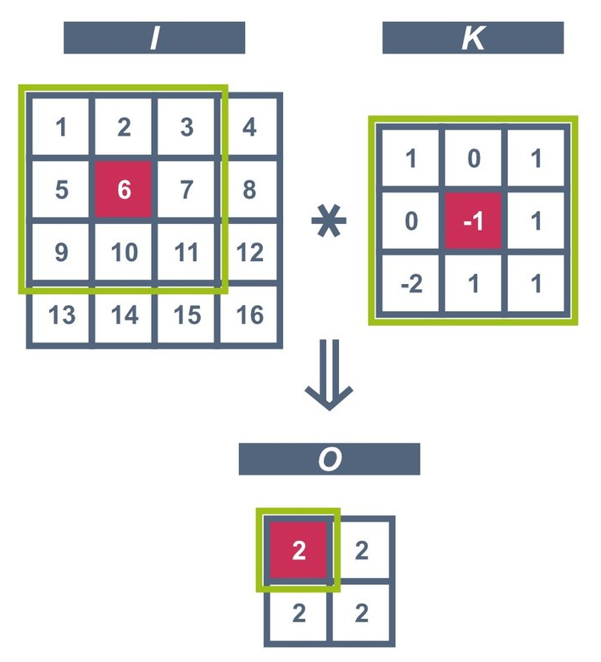
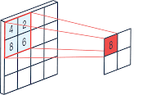
Shape recognition with AI Convolution and MaxPooling
2D Convolution
Max Pooling
A max pooling layer does not have any trainable weights, it acts as an hyperparameter used to reduce the dimensionality after convolutional layers.
The network will learn which convolutional weights need to be applied to extract features.

Slide 12
Shape recognition with AI Classification and Output Layers
In our application, we used fully connected layers with a ReLu activation function, and an output layer called Softmax, which computes the degree of certainty for a sample to belong to a certain class.
________________________________________________________
Layer (type) Output Shape Param #
========================================================
dropout (Dropout) (None, 4, 4, 30) 0
flatten (Flatten) (None, 480) 0
dense (Dense) (None, 500) 240500
dropout (Dropout). (None, 500) 0
dense (Dense). (None, 43) 21543
========================================================
This layer sets some random nodes to 0 to prevent overfitting.
Used to reshape the output of previous layers, taking a unidimensional shape.
Layer of 500 neurons fully connected between each other.
Fully connected layer that computes the likelyhood of the estimation (Softmax).

Slide 13
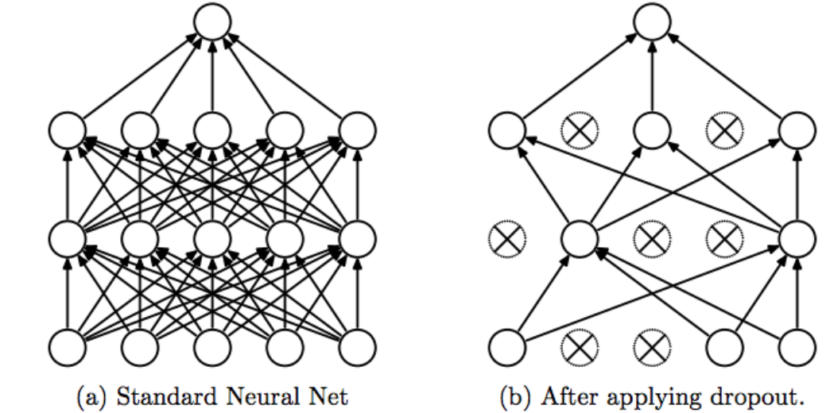
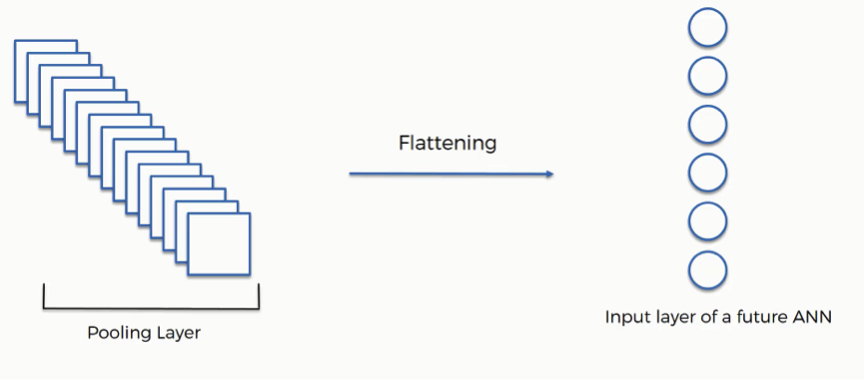
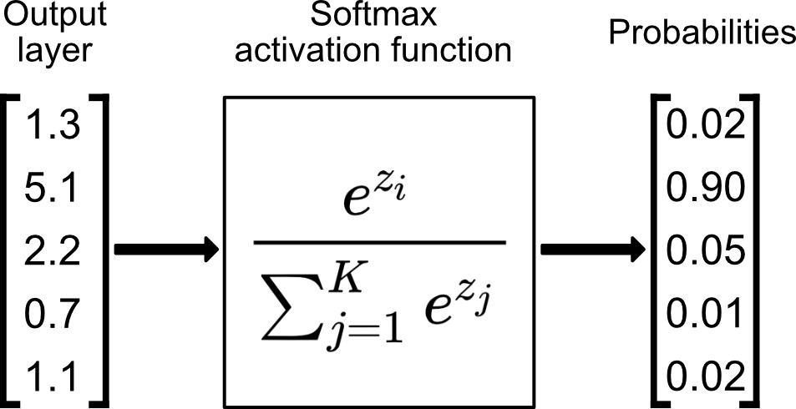
Shape recognition with AI Classification and Output Layers
Dropout
Flatten
SoftMax activation function

Slide 14
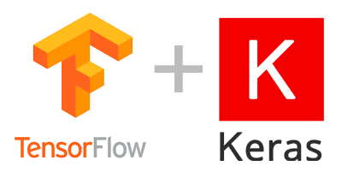

Shape recognition with AI Problems and solutions in ML
Computational power and code complexity
Richness of the database
Keras and TensorFlow allow to easily create and train your networks.
It is very common for machine learning researchers to use public databases available online as a starting point. Furthermore, in the case of having a poor database there are data augmentation techniques to manipulate it and generate a bigger ones.
Another alternative is to reuse models from other researchers, as you can continue training them with your own data to make the process faster.
Google provide powerful computers to scientists so that they can train faster the networks.

Slide 15
Implementation Pseudocode
Training
Testing
Initialization and hyperparameter definition.
Duration of the training
Input and output shape
Data regularization
Preprocess the database if needed.
Split the data into training (60%), testing (20%) and validation (20%)
Define the structure of the model that you want to train
Add input layer
Add convolution layers and MaxPooling.
Add dense layers and dropout
Add an output layer.
Train the model with training and testing sets.
Evaluate your model with the validation data
Initialization.
Import model
Import any dependencies needed
Configure a data input stream.
Preprocess raw data
Send the data to your previously trained network.
Display the resulting prediction.

Slide 16
Activity Implement your neural network
Using the pseudocode presented in this slides and make a traffic sign classifying convolutional neural network.
Practical considerations
Google colab is a free tool that most likely will outperform your computer and can be used to train neural networks.
Research Tensorflow tools to generate the layers that were presented in this presentation and train them to classify the samples.
You may use this dataset for your work https://benchmark.ini.rub.de/gtsrb_news.html

Slide 17
Activity ROS node that classify traffic signs
Make the necessary ROS code to read images from “/image_raw”, evaluate them and send your prediction.
Practical considerations
TensorFlow requires python 3.X, while ROS works with python 2.7 by default, you can see that the first line of the template script changes the python version to match this requirement.
ROS and TensorFlow image formatting is not the same, you will need to manipulate the ROS message to match them by using the function imgmsg_to_cv2(…)
You can either train a neural network with complete images or used the network previously trained and CV techniques to isolate the traffic signs.

Slide 18
Activity Proposed solution, CV and AI
Preprocess the image, cleaning and softening the data as much as possible.
Use color filtering to remove as many information that is not part of a sign as possible
Use edge detection techniques to isolate shapes and characterize them so that they match an expected shape, for instance using circularity criteria.
Crop the region that corresponds to the traffic sign.
Analyze the cropped region using your Neural Network
React according to the output of the network.

